Slide 1


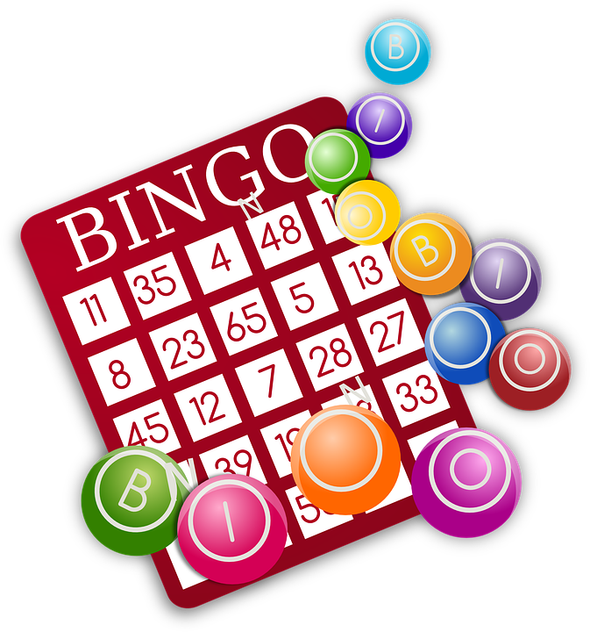

ONLINE EDUCATIONAL GAMES AS STRESS BUSTER
Dr. MALAVIKA SHARMA

Slide 2






THE CURRENT SCENARIO
LITTLE OR NO FACE-TO-FACE INTERACTION
PRONE TO TECHNICAL ISSUES
CREATES A SENSE
OF ISOLATION
PASSIVE LEARNERS
MORE SCREEN TIME

Slide 3
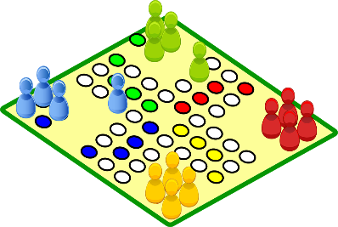
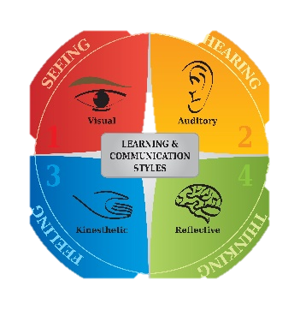


GAMES AS AN ALTERNATIVE
FUN AND ENJOYMENT
CATER TO DIFFERENT LEARNING STYLES
RELAXED AND INFORMAL ATMOSPHERE
ENHANCE INTERACTION
INVOLVES ALL LEARNERS
This Photo by Unknown Author is licensed under CC BY-SA-NC

Slide 4



EDUCATIONAL ELEMENT OF GAMES
ENABLES THE LEARNERS TO THINK
IMPLEMENT NEW WAYS TO TACKLE THE GAME
FOSTER DEEP LEARNING

Slide 5
OBJECTIVE OF MY TALK
INTRODUCE ONLINE GAMES
REDUCE STRESS
ENCOURAGE REFLECTION
INVOLVE ALL IN THE LEARNING PROCESS

Slide 6
HIT THE SPACESHIP
CLICK ON THE LINK GIVEN IN THE CHAT BOX. YOU WILL BE DIRECTED TO THE GAME IN POWERPOINT.
GO TO ‘FILE’ AND DOWNLOAD THE GAME.
CLICK ON THE SLIDE SHOW MODE TO PLAY THE GAME.
YOU WILL FIND A “START” BUTTON. CLICK ON THE BUTTON AND THE SPACESHIPS WILL MOVE FROM ONE END TO ANOTHER.
HIT THE SPACESHIP TO EARN A POINT. THE GAME IS TIMED. YOU HAVE TO HIT ALL THE SPACESHIPS IN ONE MINUTE .

Slide 7


DISCUSSION
WHAT IS THE PURPOSE OF THE GAME?
WHAT DID I LEARN?
DID I LEARN SOMETHING NEW?
DID I COMPLETE THE GAME IN THE TIME ALLOTTED?
DO I NEED TO TRY OUT A DIFFERENT WAY TO WIN THE GAME?

Slide 8
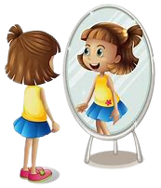
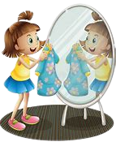
WHAT IS REFLECTION?
OBSERVES HERSELF CAREFULLY
ADJUSTS HER CLOTHES, MAKE-UP TO SUIT THE OCCASION
REFLECTION IS A SERIOUS THOUGHT THAT ALLOWS LEARNERS TO CONSIDER

Slide 9


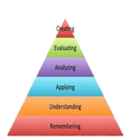
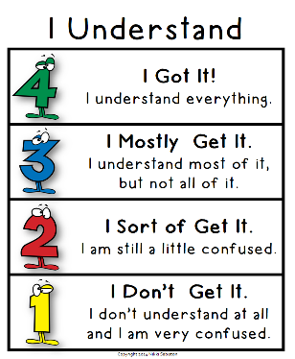
THE PURPOSE OF REFLECTION
GIVES TEACHER OPPORTUNITY FOR REFORMULATION
ALLOWS LEARNER TO EVALUATE THEIR UNDERSTANDING
DEVELOPS HIGHER ORDER THINKING SKILLS
TRANSFER LEARNING TO OTHER SITUATIONS

Slide 10

HOW DO WE INTRODUCE REFLECTION IN THE CLASSROOM?
SHOULD INCLUDE REFLECTIVE QUESTIONS DURING AND AFTER
HAVING A SPECIFIED LEARNING OUTCOME
ACTIVITIES/GAMES
ENABLING DISCUSSION WITH PEERS
INCLUSIVE
INVOLVING

Slide 11


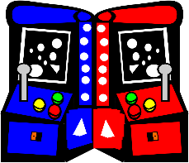

DIFFERENT ASPECTS OF DESIGNING GAMES
PLAYFULNESS
COLLECTIVE THINKING
COMPETITION
CHALLENGING
RESPONSIBLE
FOCUS

Slide 12

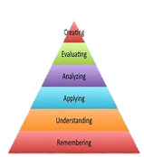


CLASSIFICATION OF GAMES
ENTERTAINMENT
LEARNING
DIGITAL INTERACTIONS
DEFINED LEARNING OUTCOMES
FUN AND REWARDING
ACHIEVES SHORT AND LONG TERM GOALS

Slide 13
FIND THE LOST MAN
CLICK ON THE LINK GIVEN IN THE CHAT BOX. YOU WILL BE DIRECTED TO THE GAME IN POWERPOINT.
GO TO ‘FILE’ AND DOWNLOAD THE GAME.
CLICK ON THE SLIDE SHOW MODE TO PLAY THE GAME.
YOU WILL FIND A HOUSE THAT IS LOCKED.
A MAN IS LOCKED INSIDE THE HOUSE.
YOU HAVE TO FIND THE CORRECT KEY TO UNLOCK THE HOUSE.
YOU CAN THEN EXPLORE THE HOUSE FOR CLUES THAT WILL HELP YOU TO FIND THE MAN.

Slide 14
TYPES OF LEARNING GAMES
TEACHING
TESTING
BOTH DESIGN KEEPING IN MIND THE ELEMENT OF ENJOYMENT AND FUN

Slide 15
TREASURE HUNT GAME
CLICK ON THE LINK GIVEN IN THE CHAT BOX. YOU WILL BE DIRECTED TO THE GAME IN POWERPOINT.
GO TO ‘FILE’ AND DOWNLOAD THE GAME.
CLICK ON THE SLIDE SHOW MODE TO PLAY THE GAME.
YOU WILL FIND NUMBERS WRITTEN FROM 1-8.
YOU HAVE TO FIND THE TREASURE THAT IS HIDDEN BEHIND ONE OF THE NUMBERS.
YOU CAN RANDOMLY SELECT ANY NUMBER.

Slide 16
STRESS BUSTER
ENJOYMENT
FUN
FORGET ALL WORRIES
TRANSFORMED TO THE VIRTUAL WORLD

Slide 17
FUN WITH OBJECTS
CLICK ON THE LINK GIVEN IN THE CHAT BOX. YOU WILL BE DIRECTED TO THE GAME IN POWERPOINT.
GO TO ‘FILE’ AND DOWNLOAD THE GAME.
CLICK ON THE SLIDE SHOW MODE TO PLAY THE GAME.
YOU WILL FIND THREE OBJECTS MOVING FROM ONE END TO ANOTHER.
YOUR TASK IS TO CLICK ON THE BALL WHILE IT IS MOVING.
ON CLICKING THE BALL YOU ARE SUPPOSED TO SOLVE A TASK .
ON SUCCESSFUL COMPLETION OF THE TASK, YOU WIN THE GAME.

Slide 18





THANK YOU!
msharma@mes.ac.in
9821771141
Malavika’s Magic

